Slide 1
TEAM-6 Mail Order Pharmacy
MANALI BAGUL
MADHUR DEOKAR
SUJAY THAKUR
SHRESHTHA CHOPRA

Slide 2
AGENDA
3. HARDWARE AND SOFTWARE REQUIREMENTS
4. INTRODUCTION
5. MICROSERVICES USED
6. MICROSERVICES OVERVIEW
8. WEB PORTAL(MVC)
9. USE CASE DIAGRAM
10. MODEL CLASSES
13. WEBPORTAL AND LOGIN PAGES
14. HOME ,AVAILABLE DRUGS PAGES
15.H2 CONSOLE
16.PROJECT DEPLOYMENT IN AWS

Slide 3
HARDWARE AND SOFTWARE REQUIREMENTS
1. Hardware Requirement:
a. Developer Desktop PC with 8GB RAM.
2. Software Requirement (Java):
a. Spring Tool Suite (STS) Or any Latest Eclipse.
i. Have PMD Plugin, Ecl Emma Code Coverage Plugin and AWS Code Commit Enabled.
ii. Configure Maven in Eclipse.
b. Maven.
c. Docker (Optional).
d. Postman Client in Chrome / Swagger

Slide 4
INTRODUCTION
The term “pharmacy“ is the clinical health science that links medical science with chemistry and it is charged with the discovery, production, disposal, safe and effective use, and control of medications and drugs at stores.
This Mail Order Pharmacy can be used to order all the medicines from pharmacy store from the ease of your home.

Slide 5
MICROSERVICES USED
1. Authorization Microservice
2. Drug Microservice
3. Subscription Microservice
4. Refill Microservice

Slide 6
MICROSERVICES OVERVIEW
1. Authorization:-
Authorization Module is a Middleware Microservice that performs following operations:-
1.1 Login Details.
1.2 Generate Token for User.
2. Drug Service:-
Drug Service Module is a Middleware Microservice that performs the following operations:-
2.1 Display all the Available Drugs.
2.2 Search Drugs by Id and Name

Slide 7
MICROSERVICES OVERVIEW
3. Subscription Service:-
Subscription Service Module is a Middleware Microservice that performs the following operations:-
3.1 Subscribe to a prescribed Drug for ordering.
3.2 Unsubscribe to any type of Drugs.
4. Refill Service:-
Refill Service Module is a Middleware Microservice that performs the following operations:-
4.1 Refill to a already prescribed Drug for ordering.
4.2 Check the Refill due Date.

Slide 8
WEB PORTAL(MVC)
4. WEB Portal
A Web Portal that allows a user to Login and allows to do following operations:-
4.1 Login.
4.2 Available Drugs by Online Pharmacy
4.3 Search Drugs
4.4 Subscribe to the Prescribe Drugs.
4.5 Refill the drugs to continue the service

Slide 9
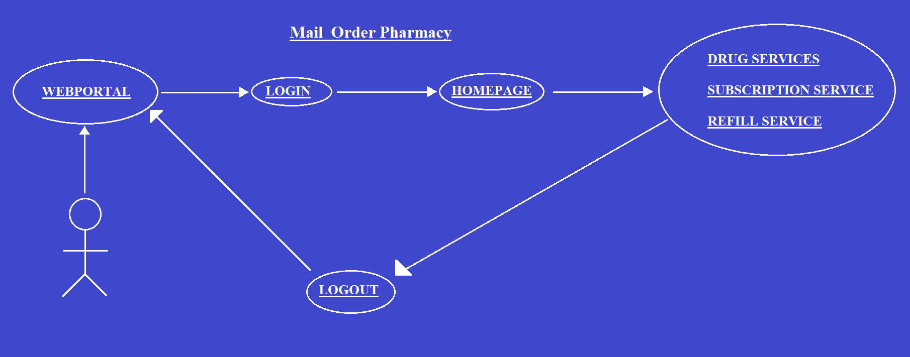
USE CASE DIAGRAM
User

Slide 10
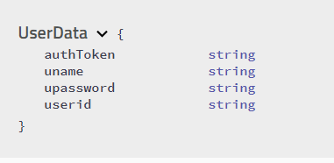
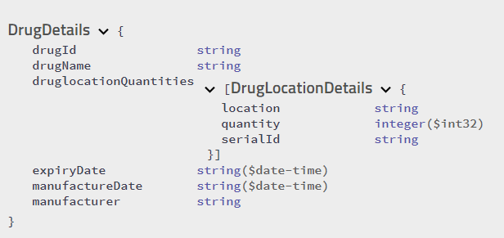
MODEL CLASSES(SWAGGER)

Slide 11
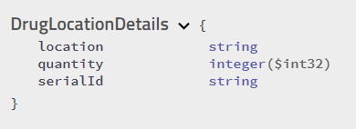
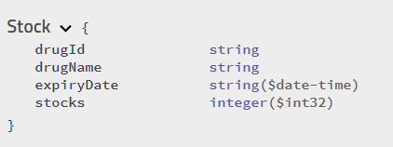
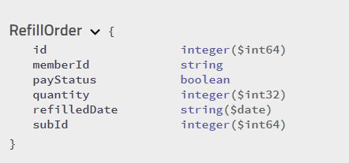
MODEL CLASSES(SWAGGER)

Slide 12
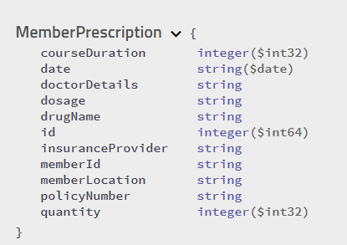
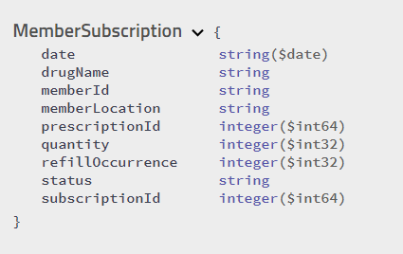
MODEL CLASSES(SWAGGER)

Slide 13
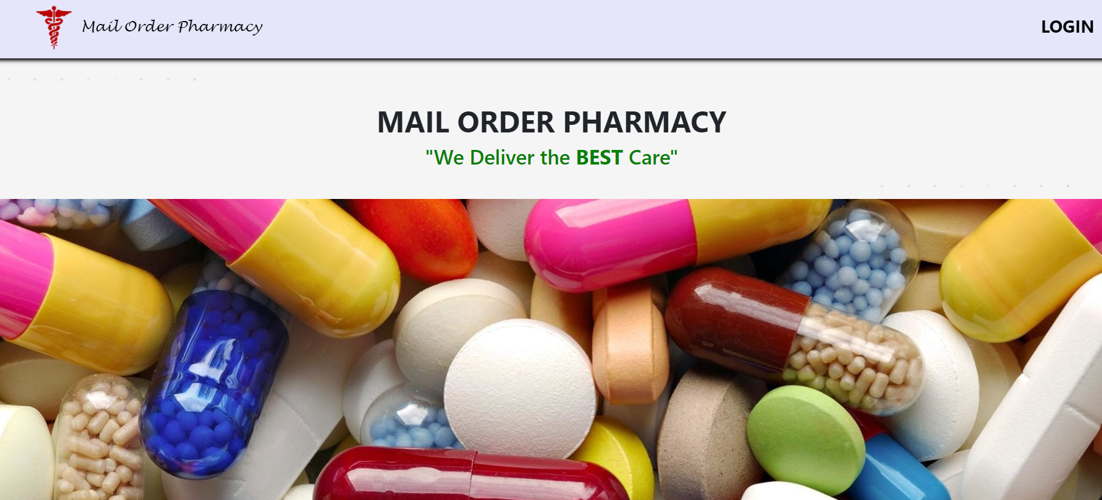
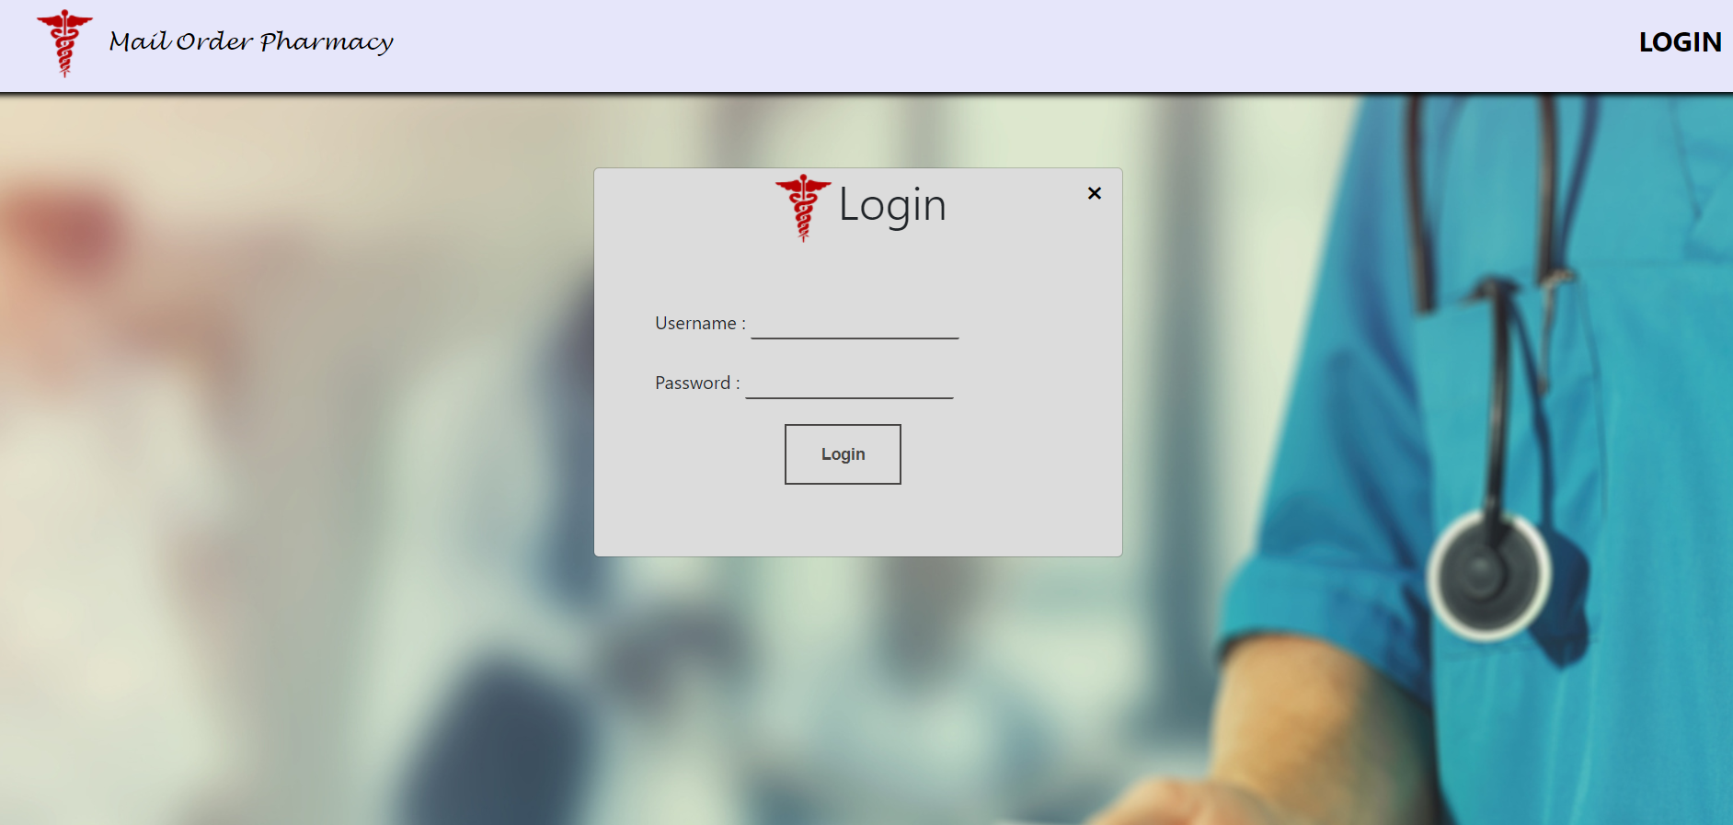
WEBPORTAL AND LOGIN PAGE

Slide 14
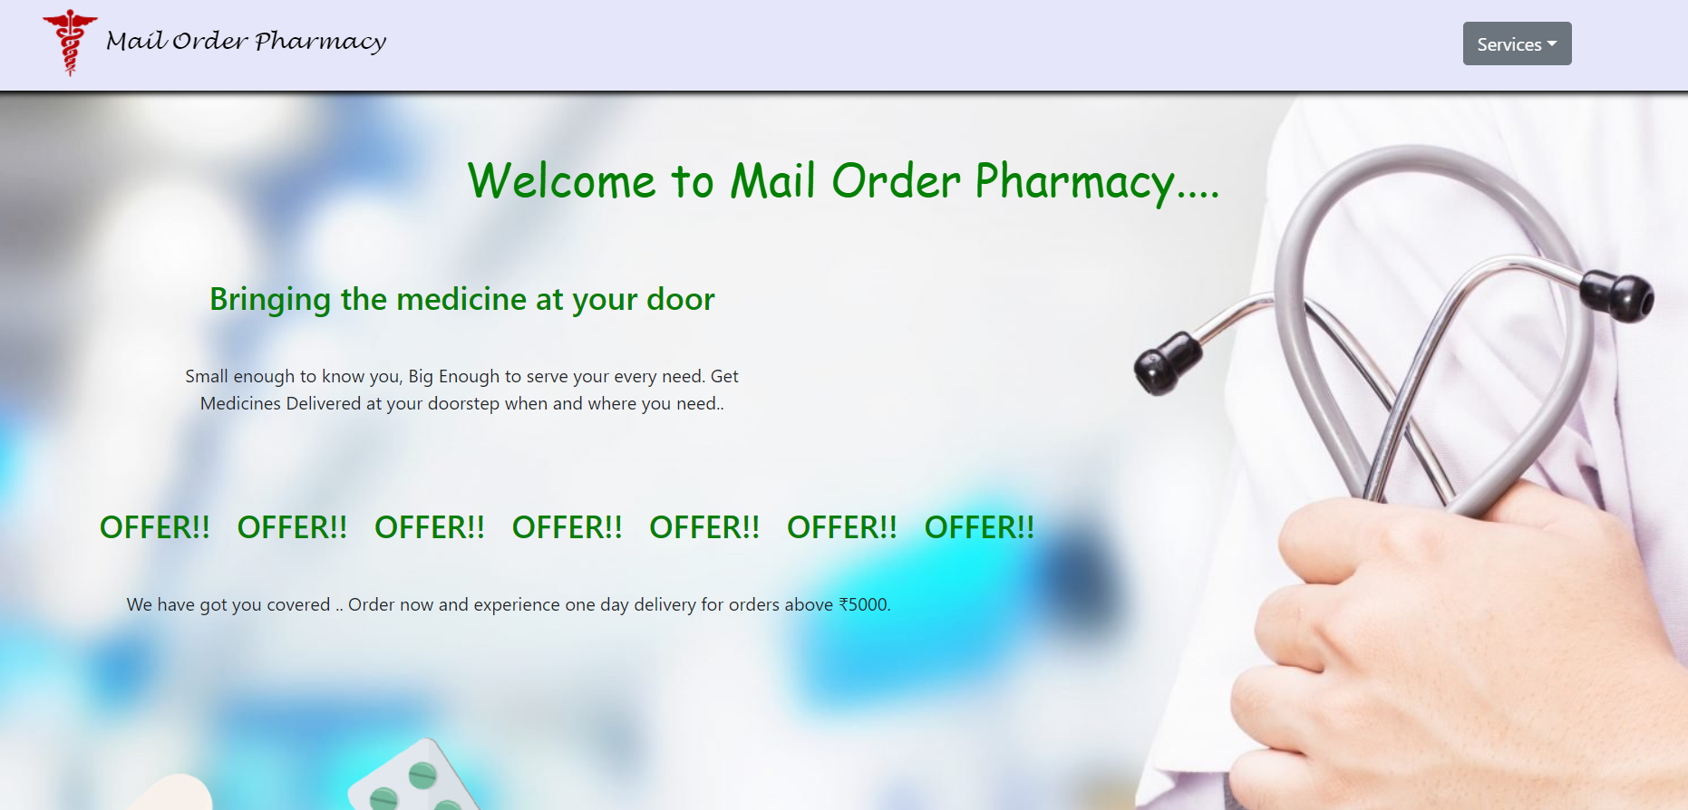
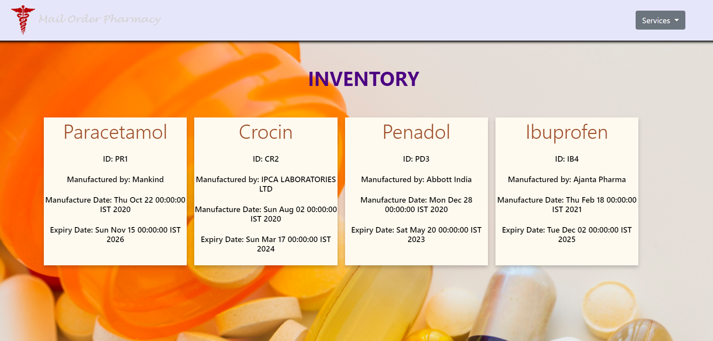
HOME PAGE AND AVAILABLE DRUGS PAGE

Slide 15
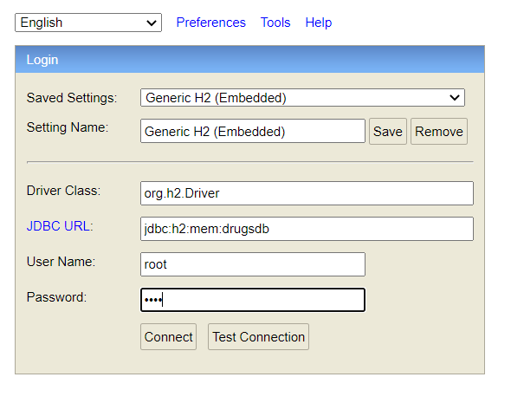
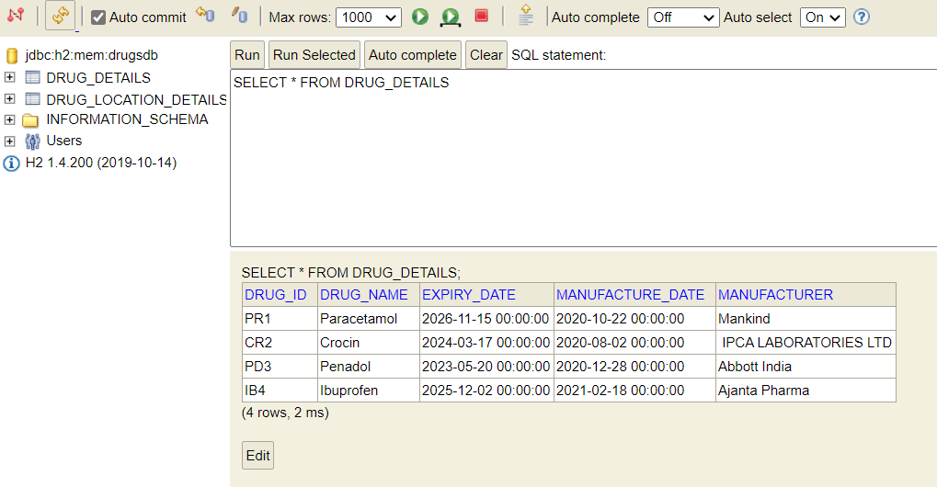
H2 CONSOLE

Slide 16

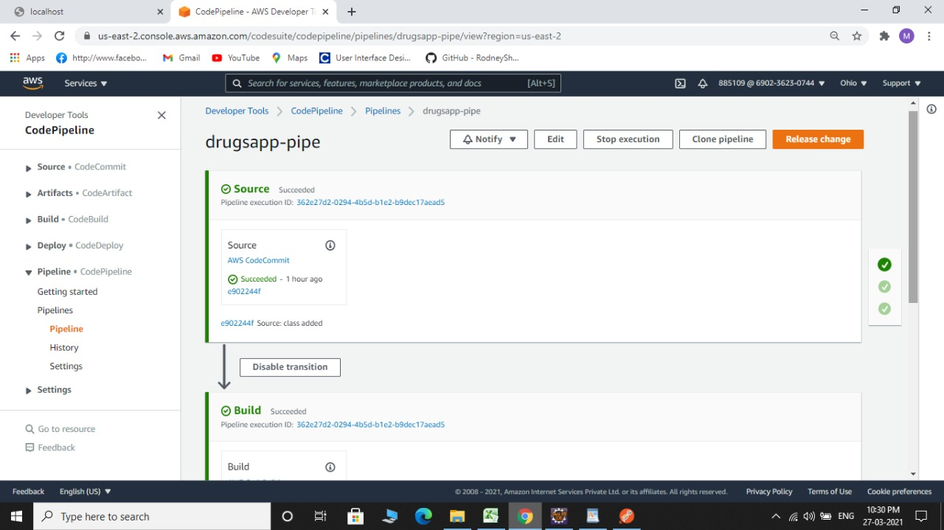
PROJECT DEPLOYMENT IN AWS

Slide 17

PROJECT DEPLOYMENT IN AWS

Slide 18
QUESTION TIME
?

Slide 19
THANK YOU

